Slide 1

Teaching Strategies or Life Sciences: Using Digital media and Scientific Experimentation
Mr D. Haiyambo Human, Biological Sciences and Translational Medical Sciences
UNAM –School of Medicine

Slide 2
Life sciences – the study of biological life
The complexity off the subject
Effective teaching strategies:
Visual aids
Integrate technology
Learning from experience
Student teaching

Slide 3
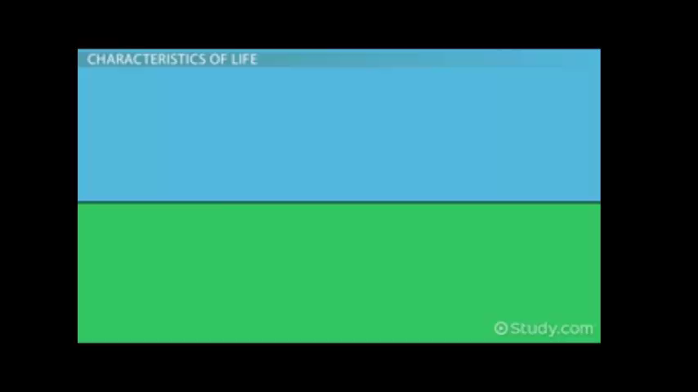
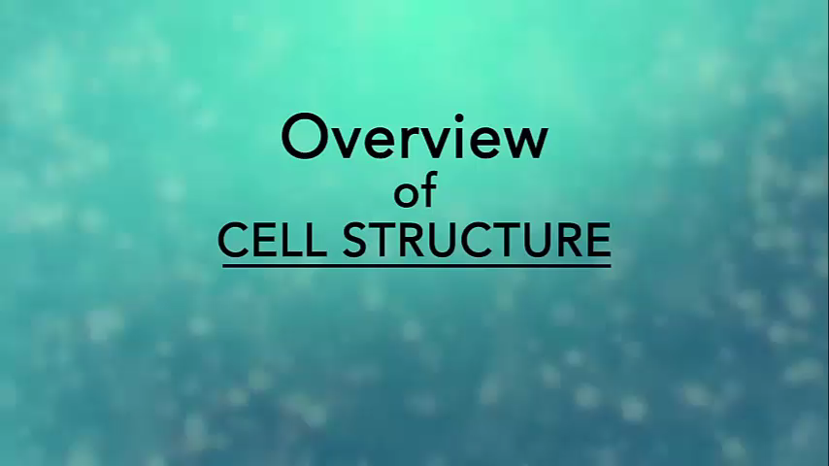
Visual Aids and Integration of technology
photographs, infographics, diagrams and videos.
Laptops, tablets, cell phones, television.
Example 1 | Example 2

Slide 4
Visual Aids and Integration of technology
Required
Computer literacy skills (video editing)
Digital media devices
Can also be useful for assessment (online quizzes)

Slide 5
Learning from Experience and Student teaching
Scientific experiments
Science kits, demonstrations
Students presentations based on research
Required
Resources (Finances)
Support services

